Slide 1
Using Twitter, DIY Math Videos from your Smart Phone, and a Cool Application of the Limit of sin(x)/x as x approaches 0
Jeff Morgan Department of Mathematics
University of Houston
jmorgan@math.uh.edu

Slide 2
Why Use Twitter?
Simplicity
Availability
Cost
Platform Freedom
Flexibility

Slide 3
Things You Should Know
Creating an Account – www.twitter.com
How do you tweet?
How do students/people follow you?
Viewing posts and responses to posts.

Slide 4
Embedded Twitter Feed in a Webpage
Twitter Widgets – Do a Google search for Twitter Widget. You will find twitter.com/about/resources/widgets
You will have to sign into Twitter and Create a Widget.
Click a few buttons, and then copy the Javascript code. Paste this into your webpage.
Example: www.math.uh.edu/~jmorgan/Math1431

Slide 5
More Tools
http://tinyurl.com – Create shorter URLs Example: tinyurl.com/math1431
http://twitvid.com
Do a Google search for “uploading video to Twitter”. You’ll find “Top 5 Ways to Share Videos on Twitter”. mashable.com/2009/05/23/video-for-twitter/

Slide 6
Tools for Your Phone
Twitter app – Places Twitter on your phone.
Depending upon your smart phone, you might want a different video app. The Iphone 4s shoots great videos, but the files are HUGE. I use the Video Camera app.
Twitvid – Allows you to post videos from your phone or PC to Twitter. Videos can be up to 1 gig in size, and up to 20 minutes on length.

Slide 7
Making a DIY Smartphone Holder to Create Help Videos for Students
Short video – http://online.math.uh.edu/HoustonACT/Morgan/DIY/DIY_Holder_Video/DIY_Holder_Video.html or http://tinyurl.com/diyholder

Slide 8
What If You Want a Web Page?
Try wordpress.com
Weebly.com
There are other free sites as well.

Slide 9
Other Useful Sites
mathcontest.uh.edu – The High School Math Contest at UH.
online.math.uh.edu/mathcircle – A program for high school students who enjoy mathematics. Our next meeting is 9/22.
online.math.uh.edu/hsmath – Resources for high school math teachers, including practice AP Calculus materials.

Slide 10
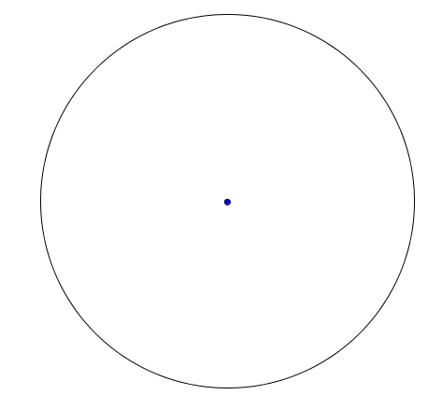
A Cool Application of the Limit of sin(x)/x as x approaches 0
Suppose a circular elastic band is stretched over a circular cylinder. Then the band will “squeeze” on the cylinder, and we can discuss the total radial tension of the band. This is the magnitude of the total force that the band exerts towards the center of the cylinder.

Slide 11
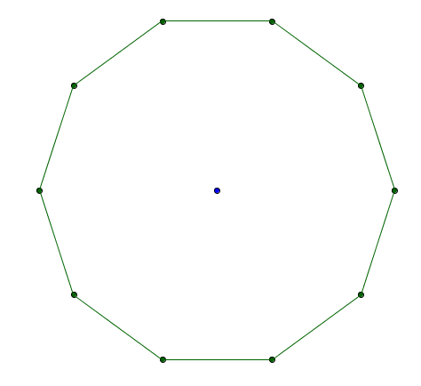
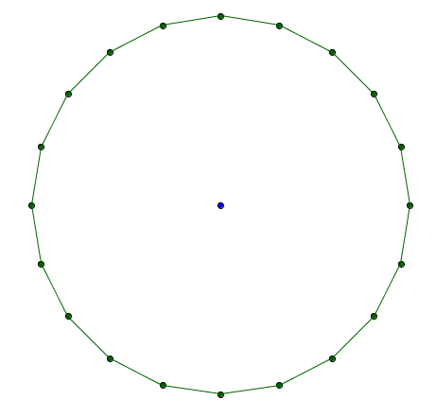
Finding the Force by Using and Approximate Problem and a Limit
One approach to finding this force is to imagine that the circular band is replaced by one that is polygonal. I show to different scenarios below. Once of these is a 10 sided polygon, and the other is a 20 sided polygon. We can see that the 20 sided polygon looks a lot like the original circle.

Slide 12
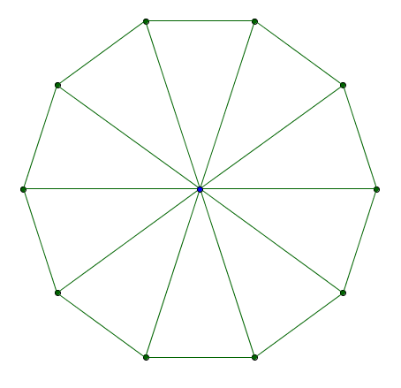
Calculations
A
B
The radial lines are drawn on the left. Although the polygon shown has 10 sides, imagine that it has m sides. Also, each of the node points will be pulled on in two different directions. Assume the magnitude of this “pull” is T. Then B is pulled towards A with magnitude T, and B is pulled towards C with magnitude C. If you determine the angle ABO, then you can find the resulting radial tension along BO resulting from these two “pulls”. You should find this to be
C
O

Slide 13
Adding the Each Radial Tension, Summing and Taking a Limit
Since there are m of these, the total radial tension for the polygonal shape is
To finish the problem, we need to “return” to the circular band. We do this by taking a limit as m goes to infinity. Can you compute the limit below?
Hint: The limit involves a trig identity, as well as the limit of sin(x)/x as x approaches 0.

