Slide 1
Are Your Students Understanding, or Simply Turning the Crank?
Jeff Morgan Interim Associate Provost for Education and Technology Innovation
University of Houston
jmorgan@math.uh.edu

Slide 2
Shameless Advertising
High School Math Contest – February 15, 2014 – http://mathcontest.uh.edu
Cedric French and Christian Haich - “AP Readers Discuss the 2013 AB Free Response Questions” – November 16, 2013
AP Calculus Help Material and Online Electronic Quizzes - http://online.math.uh.edu/apcalculus/
teachHOUSTON – http://teachHOUSTON.uh.edu

Slide 3
Fundamental Questions
Can your students describe and explain the fundamental concepts in calculus?
Can your students use fundamental concepts from calculus to work problems, even if they have not seen them before?

Slide 4
Instructions
Answer the following questions for each of the following problems.
What are the fundamental concepts associated with the problem?
What percentage of your students can successfully work the problem?
How will your “successful” students approach the problem?

Slide 5
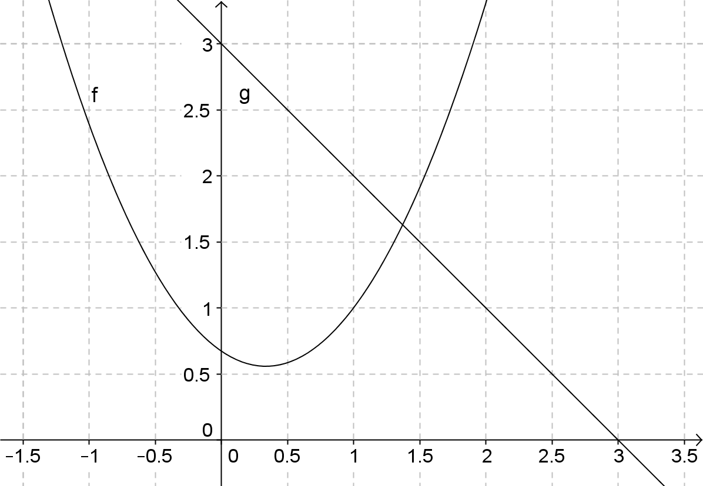

Slide 6
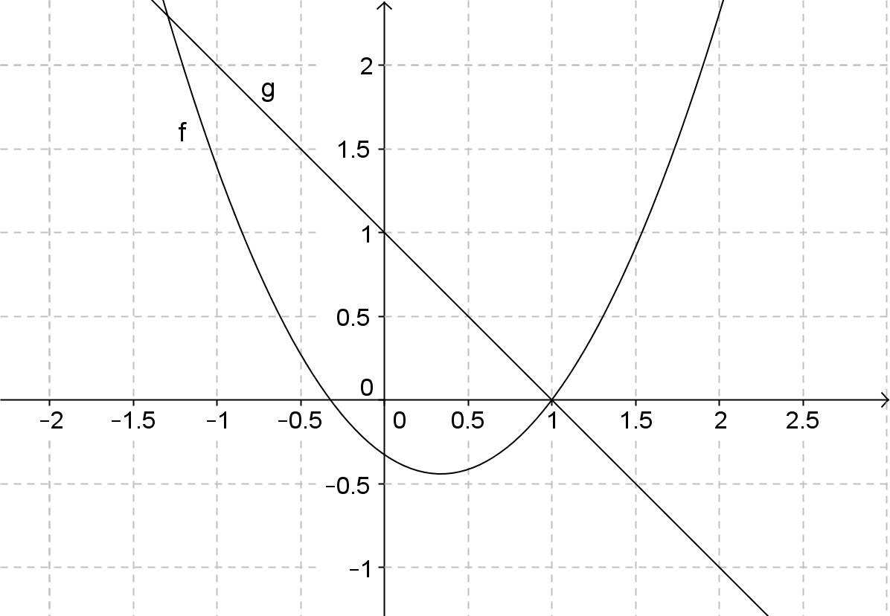

Slide 16
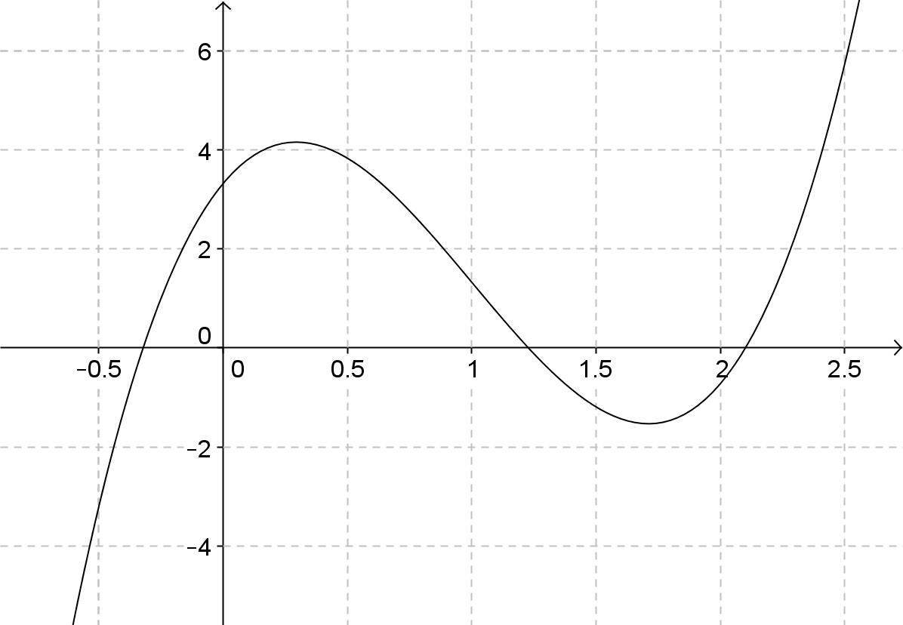

Slide 17
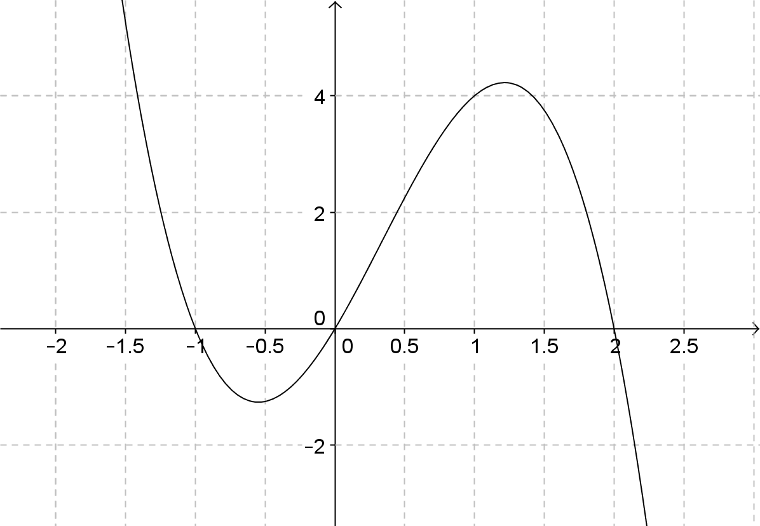

Slide 18
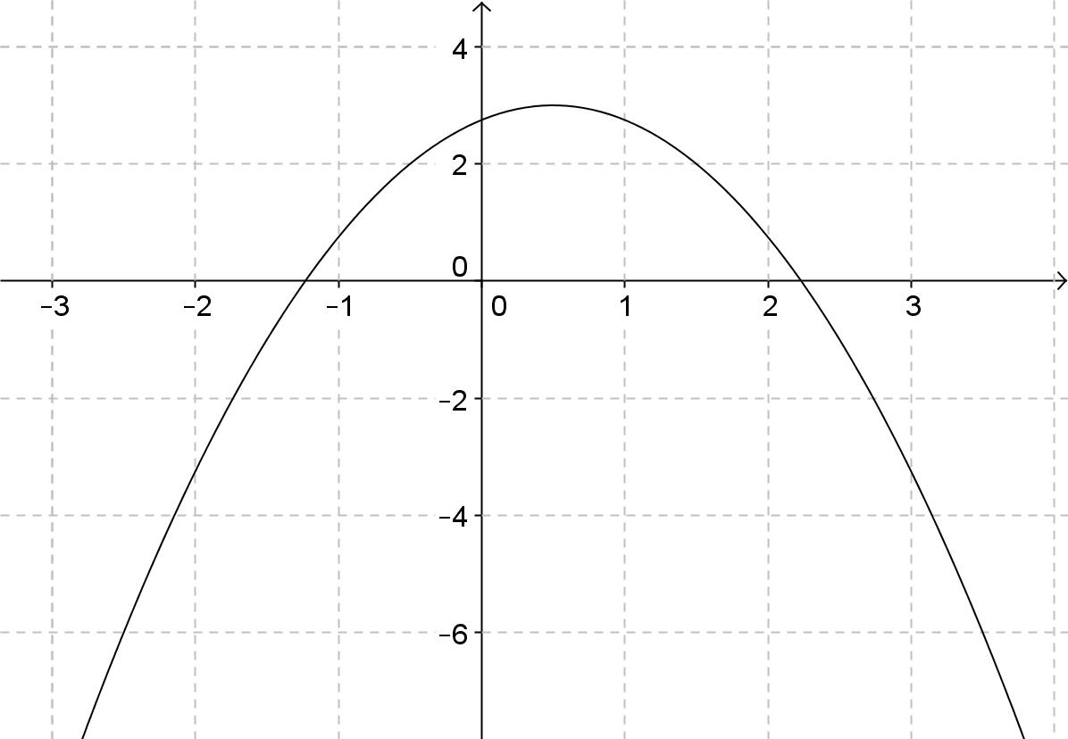

Slide 22
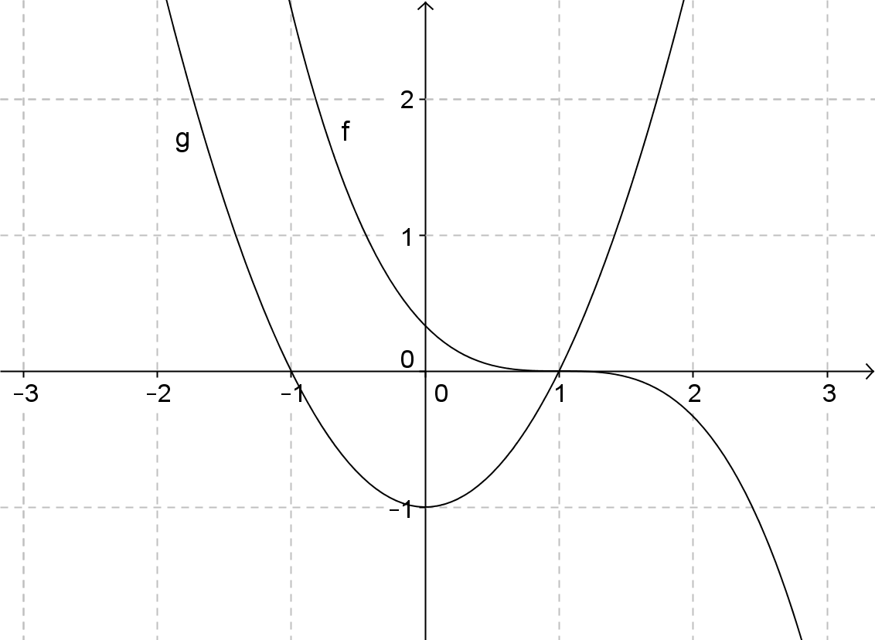

Slide 23
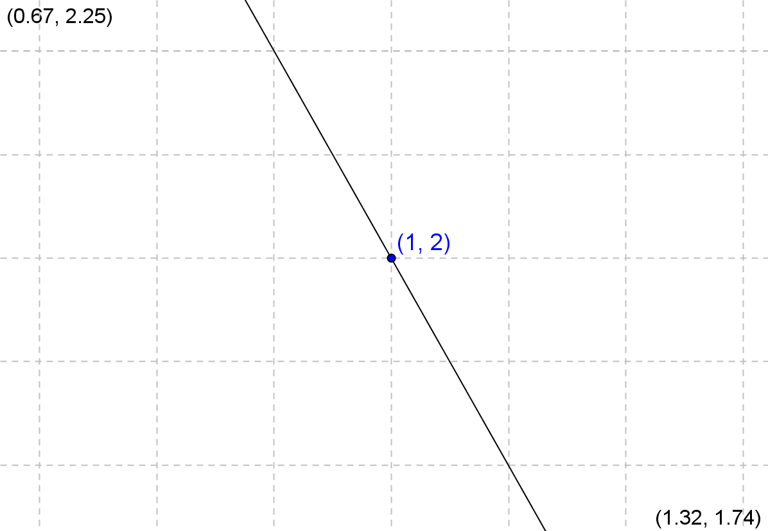

Slide 25
